Slide 1


Data Analysis
Notes:
We are going to analyze the data of Social buzz to solve there problems .
Due to their rapid growth and digital nature of their core product, the amount of data that they create, collect and must analyze is huge

Slide 2


Today's agenda
Project recap
Problem
The Analytics team
Process
Insights
Summary
Notes:
We will recap all over project and check what is needs and requirements of the project
We are going to understand what is the problem they are getting and solve it. And give brief understanding of the data
After analyzing the problems I will go to our team and proceed with the task.
We will understand , clean , visualize the data as per need
We will go deep to and check the data and give relevant table and visualization patterns to clients for understanding

Slide 3

To start our engagement with Social Buzz, we are running a
3 month initial project in order to prove to them that we
are the best firm to work with. They are expecting the
following:
- - An audit of their big data practice
- Recommendations for a successful IPO
- An analysis of their content categories that highlights
the top 5 categories with the largest aggregate
popularity
Project Recap

Slide 4



Andrew Fleming
(Chief Technical Architect)
The Analytics team
Marcus Rompton
(Senior Principle)
Tejas Kamble
(Data Analysis)

Slide 5
Data understanding
Process
1
Data cleaning
2
Data Modeling
3
4
Data visualization
5
Data Insight
Notes:
Data Understanding:-
Data Assessment: Understand data sources, quality, and challenges.
Tech Landscape: Evaluate data management tools and resource allocation.
Data Cleaning:-
Data Scrubbing: Remove errors and inconsistencies from the dataset.
Missing Values Handling: Address and manage missing data entries.
Data Modeling:-
Data Integration: Merge tables to create a unified dataset.
Category Analysis: Calculate top 5 performing categories based on aggregated scores.
Data Visualization:-
Visual Representation: Create graphs and charts to illustrate data patterns.
Insight Communication: Use visuals to convey key findings and trends.
Data insight:-
Pattern Recognition: Identify meaningful trends and correlations in data.
Inform Decision-Making: Provide actionable insights for strategic choices.

Slide 6

Insights
MONTH WITH
MOST POSTS
JANUARY
Unique Category
16
Top Categories
5

Slide 7
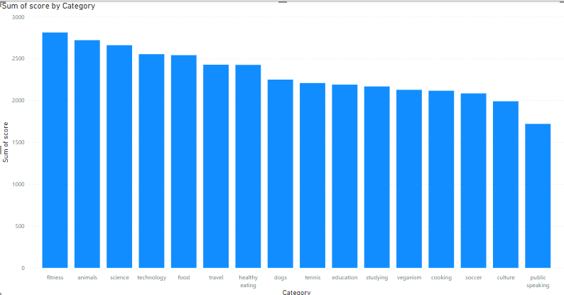

Slide 8
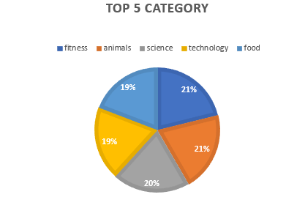

Slide 9

Analysis:
Fitness And animals are top category in this dataset .
Insight:-
Food is a common theme with the top 5 categories with "Healthy Eating" ranking the highest. This may give an indication to the audience within your user base. You could use this insight to create a campaign and work with healthy eating brands to boost user engagement.
Summary

Slide 10
Thank you!
ANY QUESTIONS?

